Slide 1








Facial Emotion Recognition
Using Generative Adversarial Network
d
Department of Computer Applications
MAJOR PROJECT (Final Viva)
Guided By:-
Dr. Balaji Banothu
(Assistant Professor)
Presented By:-
Ankush Sikarwar
(205121024)

Slide 2
Contents
Introduction
Problem Statement
Challenges in FER using GAN
Fundamentals
Framework and Algorithms
Methodology
Implementation
System Requirements
Drawbacks and Future Scope
Conclusion

Slide 3
Introduction To FER Using GAN
Definition of Facial Emotion Recognition: FER involves the automatic detection and analysis of facial expressions to infer emotional states such as happiness, sadness, anger, surprise, fear, and disgust.
Importance and Applications: It plays a crucial role in various domains, from human-computer interaction to healthcare, marketing, security, and more. There are many existing application using FER such as in customer services, recommendation system, Robotics etc.

Slide 4
Problem Statement
Facial Emotion Recognition is a multifaceted problem with significant implications for human-machine interaction, healthcare, marketing, security, and education.
However, challenges persist in enhancing their accuracy, efficiency, adaptability, and generalization.
The primary goal of FER is to develop robust algorithms and models capable of accurately recognizing and interpreting a wide range of facial expressions, enabling machines to understand and respond to human emotions effectively.

Slide 5
“Challenges in FER using GAN ”
Data quality and Diversity
Mode Collapse
Subjective and Interpretability
Computational Resources

Slide 6
Fundamentals of FER using GAN
Basics of Facial Emotion Recognition (FER): Understanding how facial expressions are represented, how they are expressed through facial movements and configurations as well as the specific considerations and techniques relevant to their integration.
Basics of Generative Adversarial Networks (GANs): Understanding the architecture of GANs, including the generator and discriminator networks, and the adversarial training process.
Integration of GANs and FER: Understanding how GANs can be used for conditional image generation, where the generator is conditioned on emotion labels to generate realistic facial expressions. Leveraging GANs to augment FER datasets by generating synthetic facial expressions.

Slide 7
Frameworks & Algorithm
TensorFlow: TensorFlow is a widely used open-source machine learning framework developed by Google. It's known for its flexibility and versatility, making it suitable for various deep learning tasks. TF provides pre-built OD models and libraries like TensorFlow OD API simplifies the process of building and training OD models.
Generative Adversarial Networks(GANs): GAN(Generative Adversarial Network) represents a cutting-edge approach to generative modeling within deep learning, often leveraging architectures like convolutional neural networks. The goal of generative modeling is to autonomously identify patterns in input data, enabling the model to produce new examples that feasibly resemble the original dataset.
It’s architecture mainly Consist of:
Generator Network
Discriminator Network
Training Adversarial Network

Slide 8
Frameworks & Algorithm
Convolutional Neural Network (CNN): A Convolutional Neural Network (CNN) is a type of deep learning model that is particularly well-suited for processing structured grid-like data, such as images. CNNs are widely used in computer vision tasks, including image classification, object detection, segmentation, and more.
It consist of several layers:
Convolutional Layer
Pooling Layer
Dense Layer
Flatten Layer

Slide 9
Data Collection and Pre-processing
Methodology
Data Sources and Types: The data sources can vary, including publicly available datasets, custom data collection, or a combination of both, that covers a wide range of object types, scales, and scenarios.
Data Annotation: The process of data annotation that involves labelling objects in the images with bounding boxes and corresponding class labels. The accurate and consistent annotation is crucial for training a reliable recognition model.

Slide 10
GAN Training
Train a Generative Adversarial Network (GAN) on the collected facial image dataset to generate synthetic facial expressions.
Build generator and discriminator network.
Define loss functions
Train the GAN until it learns to fool the discriminator so that it cannot distinguish between real or fake and generate realistic facial expressions that mimic those in the original dataset.

Slide 11
FER Model Training
Split the original dataset into training, validation, and test sets.
Augment the training dataset by generating synthetic facial expressions using the trained GAN.
Train a Facial Emotion Recognition (FER) model on the augmented training dataset, using techniques such as convolutional neural networks (CNNs).

Slide 12
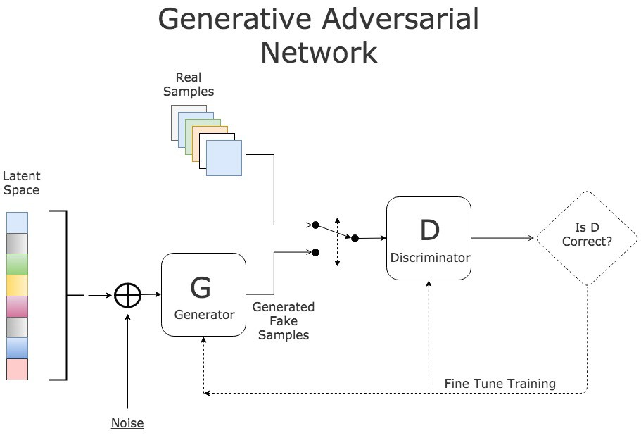
Generative Adversarial Network

Slide 13
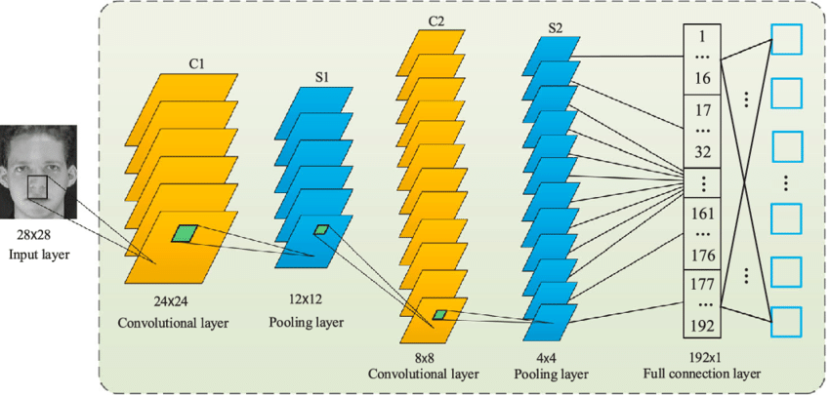
Convolutional Neural Network

Slide 14
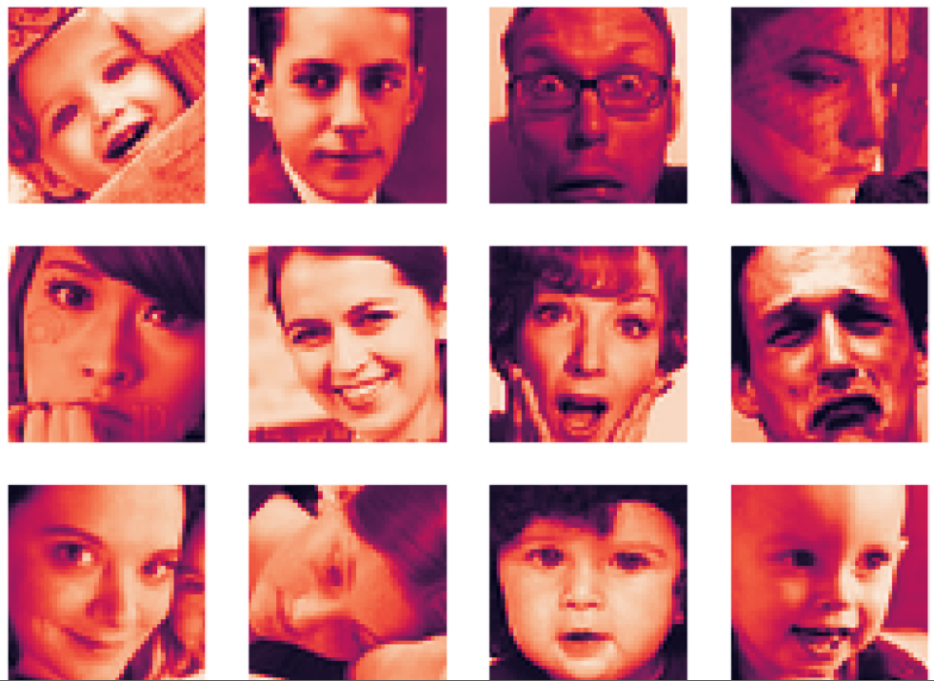
Data Collection and Preprocessing
Implementation
Collect a dataset of facial images labeled with emotion categories (e.g., happiness, sadness, anger). For example FER2013.
Preprocess the images (e.g., resize, normalize) and extract facial landmarks or features if needed.
Input Image:

Slide 15
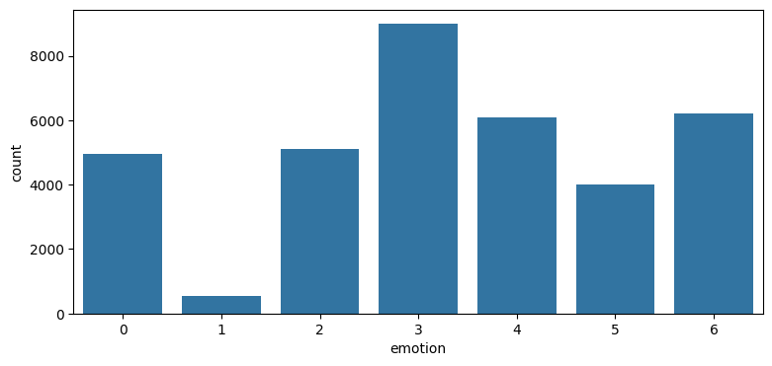
Imbalanced Dataset

Slide 16
GAN Training for Image Augmentation
Input Noise: Generate random noise vectors (latent space vectors).
Generator: Transform the noise vectors into synthetic facial expressions (images).
Discriminator: Classify whether an image is real (from the original dataset) or fake (generated by the generator).
Loss Functions: The generator aims to minimize the discriminator’s ability to differentiate between real and synthetic data.
Backpropagation: Update the generator and discriminator weights based on their performance.
Repeat these steps until the generator fools the discriminator so that it cannot distinguish between real or fake and produces convincing facial expressions.

Slide 17
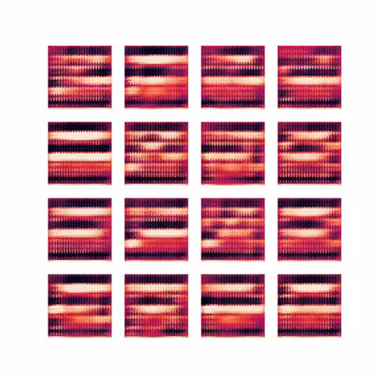
GAN Training for Image Augmentation
Generated Images:

Slide 18
FER Model Training
Split the original dataset into training, validation, and test sets.
Augment the training dataset by generating synthetic facial expressions using the trained GAN.
Design the architecture of the CNN model, including the number of convolutional layers, pooling layers, fully connected layers, and activation functions.
Train a Facial Emotion Recognition (FER) model on the augmented training dataset combined with original dataset.
Fine-tune the FER model using transfer learning if pre-trained models are available.

Slide 19
Evaluation
Evaluate the trained FER model on the validation set to assess its performance in recognizing facial expressions.
Evaluation of GAN can be in two parts qualitative and quantitative. Eg visual inspection, inception score
Perform hyperparameter tuning and model optimization to improve performance if necessary.
Evaluate the final model on the test set to obtain unbiased performance metrics.

Slide 20
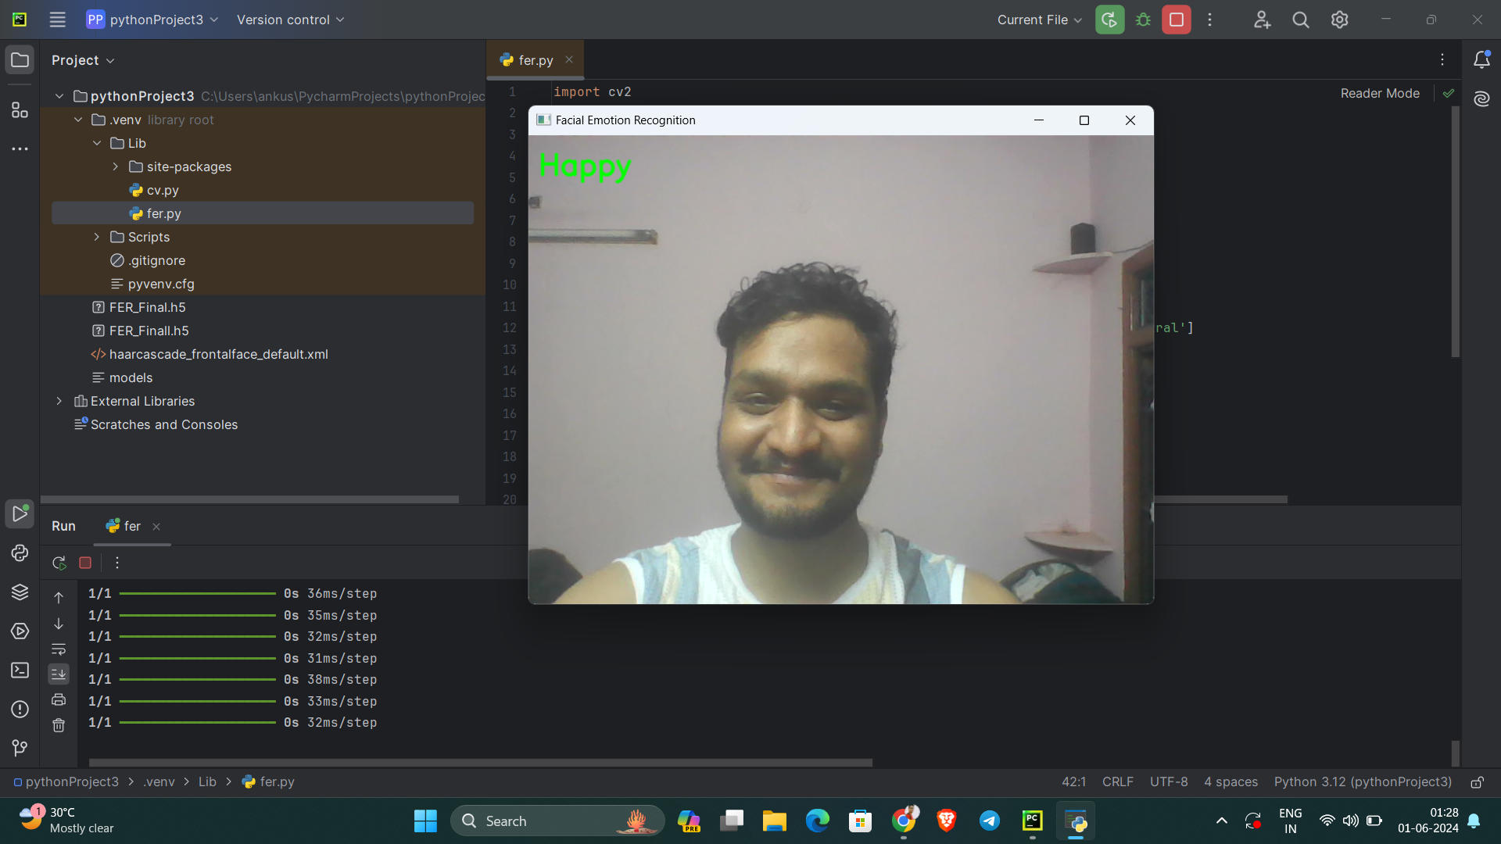
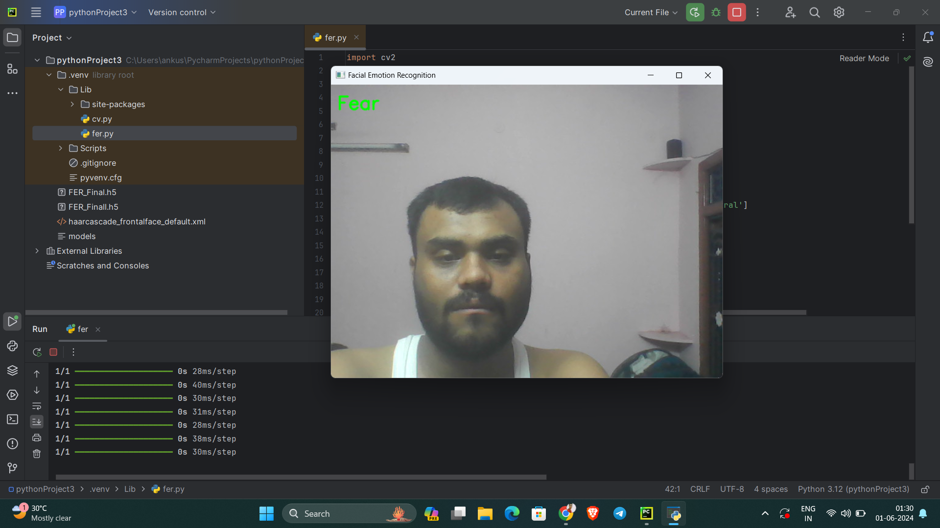
Result

Slide 21
Comparison
Traditional FER methods often rely on manually annotated dataset whereas with GAN there is more diverse of training data, helps address limitations in diversity and availability
Traditional FER use real facial images where with GAN their is synthetic generated images and quality of realism depends on architecture
Traditional FER methods rely on handcrafted features where using GAN can achieve higher accuracy by learning from more diverse data

Slide 22
System Requirements
Hardware: Modern CPU, 8GB+ RAM, SSD storage, 16GB GPU.
Software: 64-bit OS, TensorFlow Framework.
Data: Labelled datasets.
Connectivity: Stable Internet Connection.
Development Platform: Google Colab / PyCharm.

Slide 23
Some Drawbacks of FER Using GAN
Quality and Realism of Generated Images: The quality and realism of images generated by GANs may vary depending on factors such as the architecture of the GAN, the quality of the training data, and the diversity of facial expressions captured in the dataset.
Overfitting and Mode Collapse: GANs are prone to overfitting, where the generator network memorizes the training data rather than learning meaningful features. Additionally, GANs may suffer from mode collapse, where the generator produces limited variations of facial expressions or fails to capture the full diversity of the target distribution.
Data Distribution Mismatch: GANs may struggle to capture the full complexity and variability of real-world facial expressions, leading to a distribution mismatch between the generated images and real images.

Slide 24
Future Scopes in FER
Improved Realism and Diversity in Generated Data: Future research can focus on enhancing the realism and diversity of facial expressions generated by GANs. This includes developing more advanced GAN architectures, incorporating additional modalities (e.g., audio, text) into the generation process.
Emotion Synthesis for Human-Robot Interaction: GAN-generated facial expressions can be used to enhance the emotional expressiveness of robots and virtual agents, enabling more natural and empathetic interactions with humans. This could lead to advancements in social robotics, healthcare, education, and customer service.
Cross-Domain Emotion Transfer: GANs can be used to transfer emotions between different domains, such as converting facial expressions to cartoon avatars or animating still images or drawings with realistic emotions. This has applications in gaming, virtual reality, animation, and personalized communication.

Slide 25
Conclusion
In conclusion, Facial Emotion Recognition (FER) using Generative Adversarial Networks (GANs) presents a promising approach to improving the performance, diversity, and robustness of emotion recognition systems. By leveraging GANs to generate synthetic facial expressions, FER models can benefit from augmented datasets that encompass a wider range of emotions, facial expressions, and demographic characteristics.

Slide 26
Thankyou

